Slide 1
Programming JAVA {
Hiveed.java
Interface;
/* Here is where your journey for your dream begins */
}
JAVA Programming

Slide 2
Hiveed.java
Interface :
An Interface is a class which contains only Abstract method
An interface doesnot contains the constructor.
Interface
Marker Inteface
Functional Interface
JAVA Programming

Slide 3
Hiveed.java
Marker Interface :
An interface does not contain the any abstract method then it is called as the Marker interface.
All methods in the interface are abstract and access specifier in the interface is public.
All methods present in the interface must be override in the Child Class.
JAVA Programming

Slide 4
Hiveed.java
Functional Interface :
Functional inteface which contains Only one abstract method is called the functional interface.
JAVA Programming

Slide 5
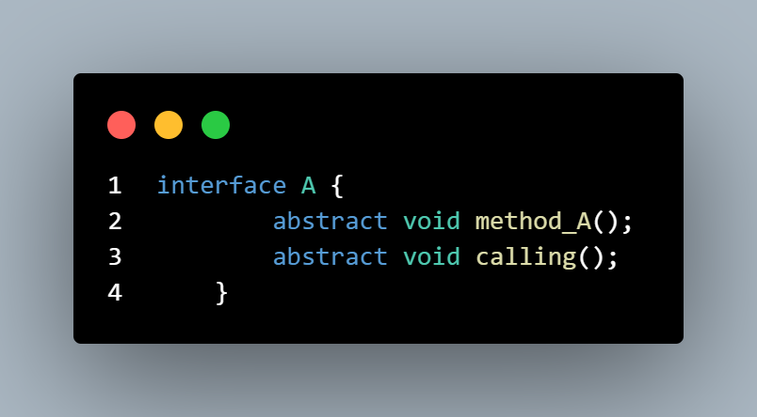
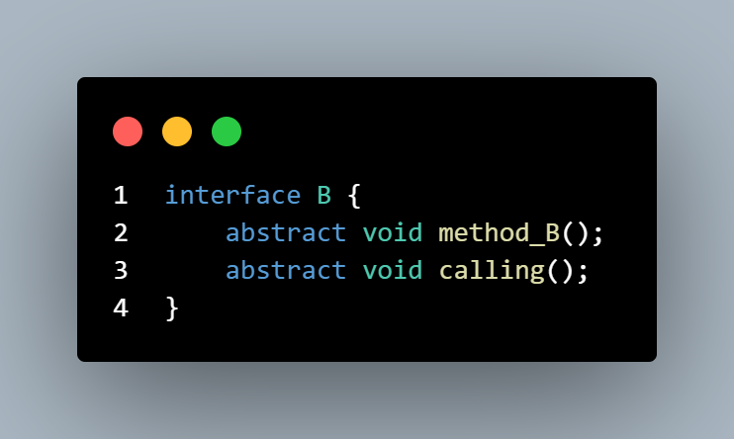
Hiveed.java
Example :
JAVA Programming

Slide 6
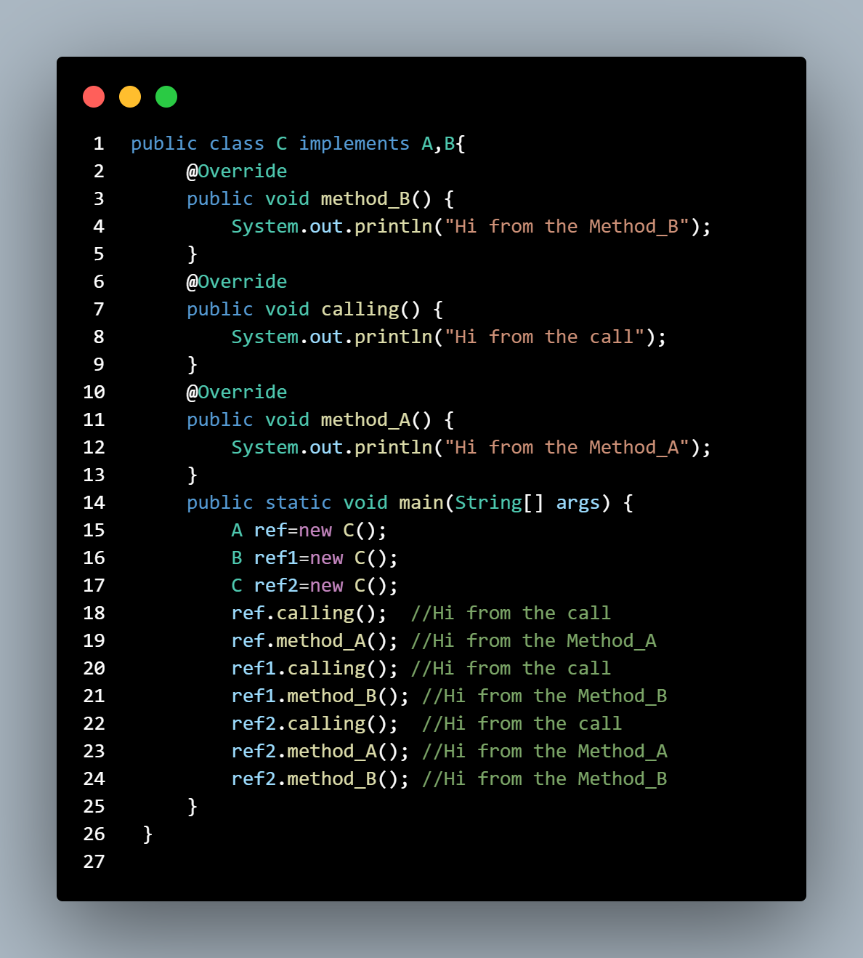
Hiveed.java
JAVA Programming

